Slide 1
TRANSACTION PROCESSING CONCEPTS

Slide 2
Chapter Outline
Introduction to Transaction Processing
Transaction and System Concepts
Desirable Properties of Transactions
Issues with concurrent transactions
2PL and TSO algorithms

Slide 3
1 Introduction to Transaction Processing
Single-User System:
  At most one user at a time can use the system.
Multiuser System:
  Many users can access the system concurrently.
Concurrency
  Interleaved processing:
    Concurrent execution of processes is interleaved in a single CPU
  Parallel processing:
    Processes are concurrently executed in multiple CPUs.

Slide 4
Transactions, Read and Write Operations, and DBMS Buffers
What is a Transaction?
The transaction is a set of logically related operation.
It contains a group of tasks.
A transaction is an action or series of actions.
It is performed by a single user to perform operations for accessing the contents of the database.
A transactions is either complete or aborted, there are no intermediate states.
A transaction usually means that the data in the database has changed.

Slide 5
Example
Example –
Transaction to be performed to withdraw cash from an ATM.
Set of Operations :
Consider the following example for transaction operations as follows.
Example -ATM transaction steps.
Transaction Start.
Insert your ATM card.
Select language for your transaction.
Select Savings Account option.
Enter the amount you want to withdraw.
Enter your secret pin.
Wait for some time for processing.
Collect your Cash.
Transaction Completed.

Slide 6
Example: Suppose an employee of bank transfers Rs 800 from X's account to Y's account. This small transaction contains several low-level tasks:
X's Account
Open_Account(X)
Old_Balance = X.balance
New_Balance = Old_Balance - 800
X.balance = New_Balance
Close_Account(X)
Y's Account
Open_Account(Y)
Old_Balance = Y.balance
New_Balance = Old_Balance + 800
Y.balance = New_Balance
Close_Account(Y)

Slide 7
Operations of Transaction:
Following are the main operations of transaction:
  Read(X): Read operation is used to read the value of X from the database and stores it in a buffer in main memory.
  Write(X): Write operation is used to write the value back to the database from the buffer.
  Commit: It is used to save the work done permanently.
  Rollback: It is used to undo the work done.

Slide 8
Let's take an example to debit transaction from an account which consists of following operations:
1. R(X);
2. X = X - 500;
3. W(X);
Let's assume the value of X before starting of the transaction is 4000.
  The first operation reads X's value from database and stores it in a buffer.
  The second operation will decrease the value of X by 500. So buffer will contain 3500.
  The third operation will write the buffer's value to the database. So X's final value will be 3500.

Slide 9
But it may be possible that because of the failure of hardware, software or power, etc. that transaction may fail before finished all the operations in the set.
For example: If in the above transaction, the debit transaction fails after executing operation 2 then X's value will remain 4000 in the database which is not acceptable by the bank.

Slide 10
Why recovery is needed?
Transaction submitted for execution
DBMS is responsible for making sure that either
  All operations in transaction are completed successfully and the changes is recorded permanently in the database.
  The DBMS must not permit some operations of a transaction T to be applied to the DB while others of T are not.
  (will cause inconsistency)

Slide 11
Failures Type
  Generally classified as
  Transaction Failure
  System Failure
  Media Failure
Notes:
Catastrophe มหันตภัย

Slide 12
Types of Failures
A computer failure(system crash): A hardware, software or network error occurs in the computer system during transaction execution.
A transaction or system error: some operations may cause it to fail like, division by zero. Also because of logical program error.
Local errors or exception detected: failure because of data not available. Such as insufficient balance, fraud withdrawal to be cancelled.
Concurrency control enforcement: it may allow to abort and restart later.
Disk failure: Some disk may loose the data because of read and write malfunction.
Physical problem: power failure, AC failure, fire, overwriting. etc
Notes:
Catastrophe มหันตภัย

Slide 13
Transaction states and additional Operation
For recovery purpose, the system needs to keep track of when the transaction
  starts,
  terminates,
  and commits or aborts.

Slide 14
Transaction Operations
The low level operations performed in a transaction are −
begin_transaction − A marker that specifies start of transaction execution.
read_item or write_item − Database operations that may be interleaved with main memory operations as a part of transaction.
end_transaction − A marker that specifies end of transaction.
commit − A signal to specify that the transaction has been successfully completed in its entirety and will not be undone.
rollback − A signal to specify that the transaction has been unsuccessful and so all temporary changes in the database are undone. A committed transaction cannot be rolled back.

Slide 15
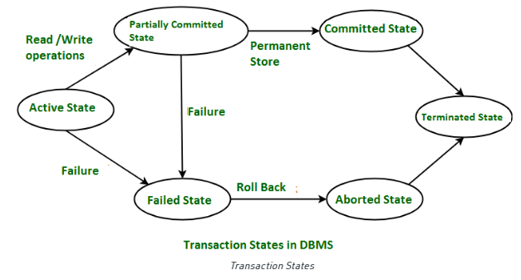
Transaction States

Slide 16
Active − The initial state where the transaction enters is the active state. The transaction remains in this state while it is executing read, write or other operations.
Partially Committed − The transaction enters this state after the last statement of the transaction has been executed.
Committed − The transaction enters this state after successful completion of the transaction and system checks have issued commit signal.
Failed − The transaction goes from partially committed state or active state to failed state when it is discovered that normal execution can no longer proceed or system checks fail.
Aborted − This is the state after the transaction has been rolled back after failure and the database has been restored to its state that was before the transaction began.

Slide 17
Desirable properties of transaction : ACID properties
To ensure integrity of data, we require that the database system maintain the following properties of the transactions:
  Atomicity.
  Consistency preservation.
  Isolation.
  Durability or permanency.

Slide 18
ACID
Atomicity. Either all operations of the transaction are reflected properly in the database, or none are.
Consistency. Execution of a transaction in isolations (that is, with no other transaction executing concurrently)
Isolation. Even though multiple transactions may execute concurrently, the system guarantees that, for every pair of transactions T_{i} and T_{j}, it appears to T_{i} that
  either T_{j} finished execution before T_{i} started,
  or T_{j} started execution after T_{i} finished.
  Thus, each transaction is unaware of other transactions executing concurrently in the system.
(Execution of transaction should not be interfered with by any other transactions executing concurrently)
Durability. After a transaction completes successfully, the changes it has made to the database persist, even if there are system failures.
(The changes must not be lost because of any failure)

Slide 19
Concurrent transactions
In a multi-user system, multiple users can access and use the same database at one time, which is known as the concurrent execution of the database.
It means that the same database is executed simultaneously on a multi-user system by different users.

Slide 20
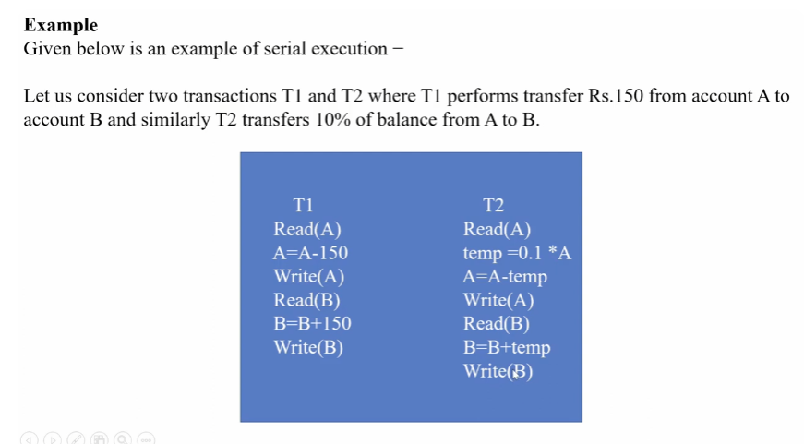


Slide 21
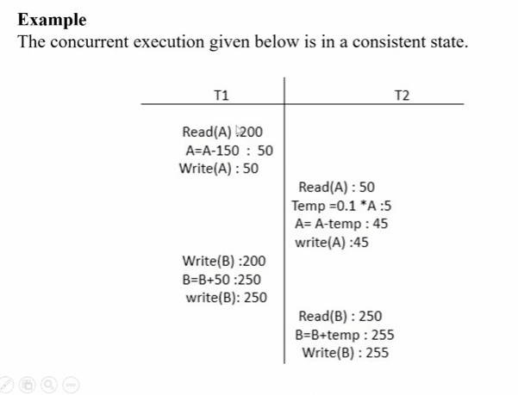

Slide 22
Issues with concurrent transactions
Lost update problem
Temporary update problem
Incorrect summary problem

Slide 23
Why Concurrency Control is needed:
The Lost Update Problem (W - W Conflict)
  This occurs when two transactions that access the same database items have their operations interleaved in a way that makes the value of some database item incorrect.
The Temporary Update (or Dirty Read) Problem (W-R Conflict)
  This occurs when one transaction updates a database item and then the transaction fails for some reason.
  The updated item is accessed by another transaction before it is changed back to its original value.
The Incorrect Summary Problem
  If one transaction is calculating an aggregate summary function on a number of records while other transactions are updating some of these records, the aggregate function may calculate some values before they are updated and others after they are updated.

Slide 24
LOST UPDATE PROBLEM
  This occurs when two transactions that access the same database items have their operations interleaved in a way that makes the value of some database item incorrect.
For example:
Consider the below diagram where two transactions T_{X} and T_{Y}, are performed on the same account A where the balance of account A is $300.

Slide 25
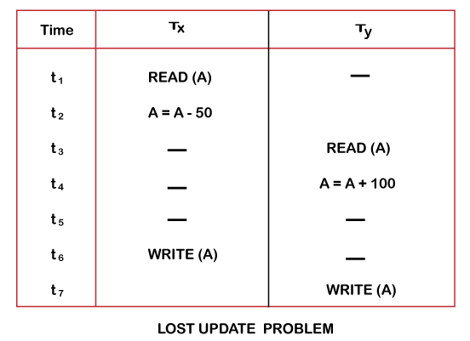
At time t1, transaction T_{X} reads the value of account A, i.e., $300 (only read).
At time t2, transaction T_{X} deducts $50 from account A that becomes $250 (only deducted and not updated/write).
Alternately, at time t3, transaction T_{Y} reads the value of account A that will be $300 only because T_{X} didn't update the value yet.
At time t4, transaction T_{Y} adds $100 to account A that becomes $400 (only added but not updated/write).
At time t6, transaction T_{X} writes the value of account A that will be updated as $250 only, as T_{Y} didn't update the value yet.
Similarly, at time t7, transaction T_{Y} writes the values of account A, so it will write as done at time t4 that will be $400. It means the value written by T_{X} is lost, i.e., $250 is lost.
Hence data becomes incorrect, and database sets to inconsistent.

Slide 26
DIRTY READ PROBLEM
  This occurs when one transaction updates a database item and then the transaction fails for some reason.
  The updated item is accessed by another transaction before it is changed back to its original value.
For example:
Consider two transactions T_{X} and T_{Y} in the below diagram performing read/write operations on account A where the available balance in account A is $300:

Slide 27
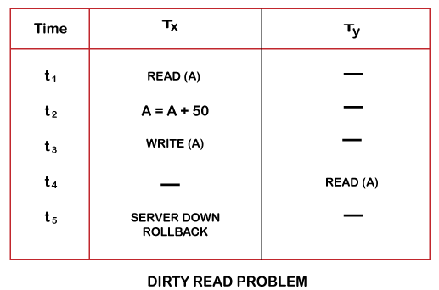
At time t1, transaction T_{X} reads the value of account A, i.e., $300.
At time t2, transaction T_{X} adds $50 to account A that becomes $350.
At time t3, transaction T_{X} writes the updated value in account A, i.e., $350.
Then at time t4, transaction T_{Y} reads account A that will be read as $350.
Then at time t5, transaction T_{X} rollbacks due to server problem, and the value changes back to $300 (as initially).
But the value for account A remains $350 for transaction T_{Y} as committed, which is the dirty read and therefore known as the Dirty Read Problem.

Slide 28
The Incorrect Summary Problem
  If one transaction is calculating an aggregate summary function on a number of records while other transactions are updating some of these records, the aggregate function may calculate some values before they are updated and others after they are updated.
  Also known as Inconsistent Retrievals Problem that occurs when in a transaction, two different values are read for the same database item.
For example:
Consider two transactions, T_{X} and T_{Y}, performing the read/write operations on account A, having an available balance = $300. The diagram is shown below:

Slide 29
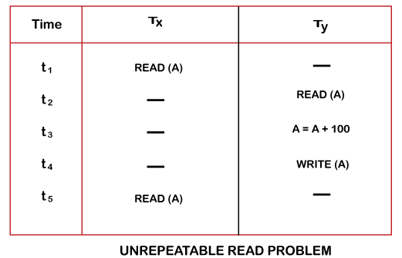
At time t1, transaction T_{X} reads the value from account A, i.e., $300.
At time t2, transaction T_{Y} reads the value from account A, i.e., $300.
At time t3, transaction T_{Y} updates the value of account A by adding $100 to the available balance, and then it becomes $400.
At time t4, transaction T_{Y} writes the updated value, i.e., $400.
After that, at time t5, transaction T_{X} reads the available value of account A, and that will be read as $400.
It means that within the same transaction T_{X}, it reads two different values of account A, i.e., $ 300 initially, and after updation made by transaction T_{Y}, it reads $400. It is an unrepeatable read and is therefore known as the Unrepeatable read problem.

Slide 30
Inconsistency problem
A = 40 , B = 50, C = 30
  T1 T2
  Read_item(A)
  SUM = Sum+A
  Read_item(B)
  SUM = A + B
  Read_item(C)
  C = C - 10
  Write_item(C)
  Read_item(A)
  A = A + 10
  Write_item(A)
  COMMIT
  Read_item(C)
  SUM = SUM + C
A = 40
A+B+C = 40+50+30 = 120
Sum = 40
B = 50
SUM = 40+50
= 90
C = 30
C = 30-10 =20
C = 20
A = 40
After
A+B+C = 50+50+20 = 120
A = 40+10 =50
A = 50
C = 20
Sum = 90 + 20 = 110

Slide 31
DBMS Concurrency Control
Concurrency Control in Database Management System is a procedure of managing simultaneous operations without conflicting with each other.
It ensures that Database transactions are performed concurrently and accurately to produce correct results without violating data integrity of the respective Database.
  Concurrent access is quite easy if all users are just reading data. There is no way they can interfere with one another.
      Though for any practical Database, it would have a mix of READ and WRITE operations and hence the concurrency is a challenge.

Slide 32
Reasons for using Concurrency control method is DBMS:
  To apply Isolation through mutual exclusion between conflicting transactions
  To resolve read-write and write-write conflict issues
  To preserve database consistency through constantly preserving execution obstructions
  The system needs to control the interaction among the concurrent transactions. This control is achieved using concurrent-control schemes.
  Concurrency control helps to ensure serializability
    E.g: Assume that two people who go to electronic kiosks at the same time to buy a movie ticket for the same movie and the same show time.
    Assume that only one seat is left !!!!!

Slide 33
Concurrency Control Protocols
Different concurrency control protocols offer different benefits between the amount of concurrency they allow and the amount of overhead that they impose.
Following are the Concurrency Control techniques in DBMS:
  Lock-Based Protocols
  Two Phase Locking Protocol
  Timestamp-Based Protocols
  Validation-Based Protocols

Slide 34
Lock-Based Protocols
In this type of protocol, any transaction cannot read or write data until it acquires an appropriate lock on it.
There are two types of lock:
  1. Shared lock:
    It is also known as a Read-only lock. In a shared lock, the data item can only read by the transaction.
    It can be shared between the transactions because when the transaction holds a lock, then it can't update the data on the data item.
  2. Exclusive lock:
    In the exclusive lock, the data item can be both reads as well as written by the transaction.
    This lock is exclusive, and in this lock, multiple transactions do not modify the same data simultaneously.

Slide 35
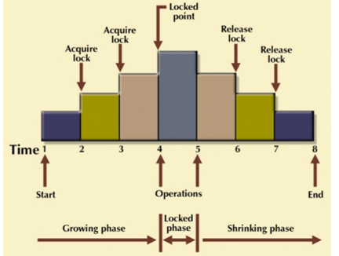
2PL ( 2 Phase – Locking )
The two-phase locking protocol divides the execution phase of the transaction into three parts.
  In the first part, when the execution of the transaction starts, it seeks permission for the lock it requires.
  In the second part, the transaction acquires all the locks. The third phase is started as soon as the transaction releases its first lock.
  In the third phase, the transaction cannot demand any new locks. It only releases the acquired locks.

Slide 36
There are two phases of 2PL:
  Growing phase: In the growing phase, a new lock on the data item may be acquired by the transaction, but none can be released.
  Shrinking phase: In the shrinking phase, existing lock held by the transaction may be released, but no new locks can be acquired.
  In the below example, if lock conversion is allowed then the following phase can happen:
  Upgrading of lock (from S(a) to X (a)) is allowed in growing phase.
  Downgrading of lock (from X(a) to S(a)) must be done in shrinking phase.

Slide 37
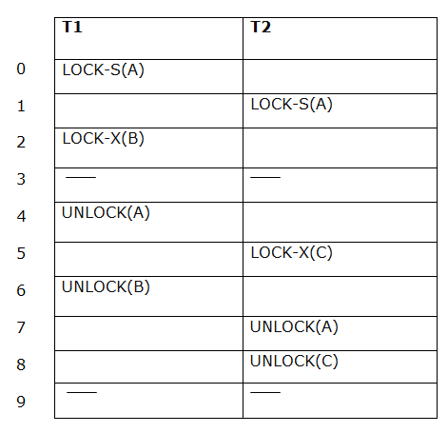
The following way shows how unlocking and locking work with 2-PL.
Transaction T1:
  Growing phase: from step 1-3
  Shrinking phase: from step 5-7
  Lock point: at 3
Transaction T2:
  Growing phase: from step 2-6
  Shrinking phase: from step 8-9
  Lock point: at 6

Slide 38
Timestamp-based Protocols
Timestamp based Protocol in DBMS is an algorithm which uses the System Time or Logical Counter as a timestamp to serialize the execution of concurrent transactions.
The Timestamp-based protocol ensures that every conflicting read and write operations are executed in a timestamp order.
  The older transaction is always given priority in this method. It uses system time to determine the time stamp of the transaction.
  This is the most commonly used concurrency protocol.

Slide 39
Timestamp-based Protocols(works)
Unique value is assigned to each transaction.
Tells the order(When they enter into the system)
Read_TS(RTS) = last(latest) transaction number which
performed read successfully.
Write_TS(WTS) = last(latest) transaction number which
performed write successfully.

Slide 40
Example:
  Suppose there are there transactions T1, T2, and T3.
  T1 has entered the system at time 0010
  T2 has entered the system at 0020
  T3 has entered the system at 0030
Priority will be given to transaction T1, then transaction T2 and lastly Transaction T3.

Slide 41
Basic Timestamp ordering protocol works as follows:
  1. Check the following condition whenever a transaction Ti issues a Read (X) operation:
    If W_TS(X) >TS(Ti) then the operation is rejected.
    If W_TS(X) <= TS(Ti) then the operation is executed.
    Timestamps of all the data items are updated.
  2. Check the following condition whenever a transaction Ti issues a Write(X) operation:
    If TS(Ti) < R_TS(X) then the operation is rejected.
    If TS(Ti) < W_TS(X) then the operation is rejected and Ti is rolled back otherwise the operation is executed.
      Where:
      TS(TI) denotes the timestamp of the transaction Ti.
      R_TS(X) denotes the Read time-stamp of data-item X.
      W_TS(X) denotes the Write time-stamp of data-item X.

Slide 42
END

